Slide 1
ECSE 527 Design Project: MEMs-Based OCT Endoscope
Timothy Perrier
11/23/2020

Slide 2
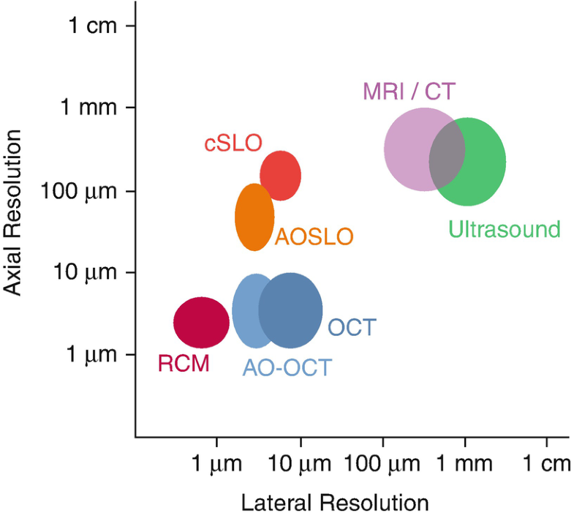
Background
Optical Coherence Tomography
Non-invasive and used for in-vivo imaging
Typically uses light from infrared range

Slide 3
OCT Challenges
Very small image size
Difficult to image larger organs
Typically small scan angles
10-20°
Short working distances

Slide 4
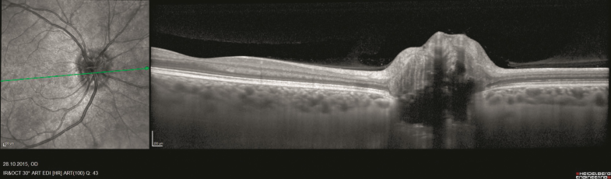
Functionality
Used to produce cross-sectional images of bodily tissue
Can produce 2D or 3D images
Laser is scanned along a sample
Detector receives light reflected from sample
Different tissue types reflect different intensities

Slide 5
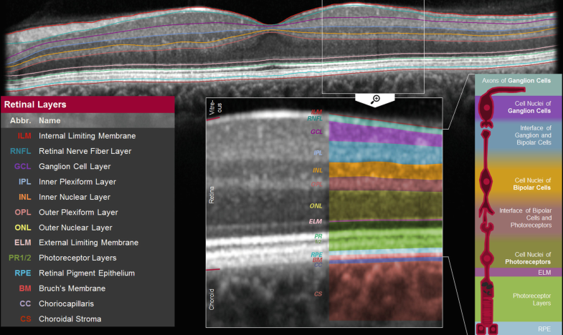
Example OCT Image and Analysis

Slide 6
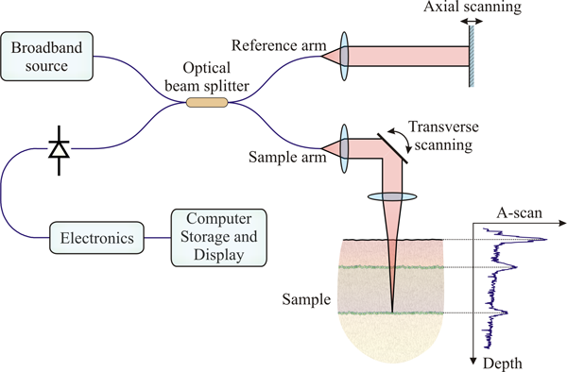
OCT System Overview
Input beam split into sample and reference
Light coming back from both arms is recombined
Detector reads reflection intensity
Back-reflection from reference and sample arms interfere and gets converted into an image

Slide 7
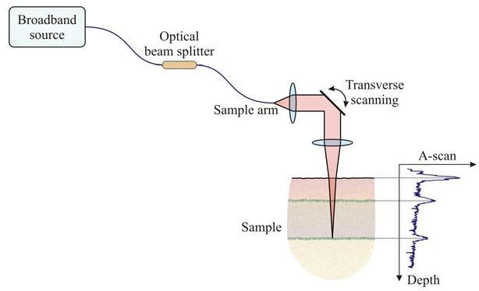
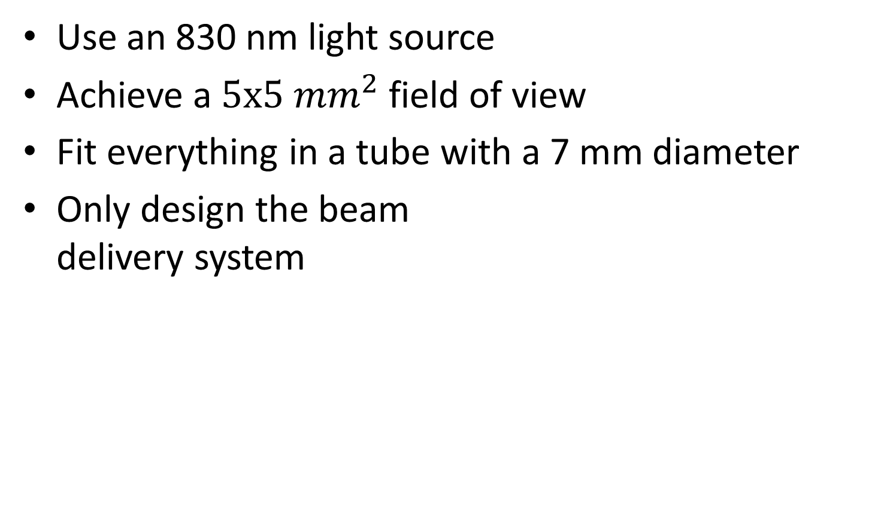
Design Specifications
Use an 830 nm light source
Achieve a $5x5 {mm}^{2}$ field of view
Fit everything in a tube with a 7 mm diameter
Only design the beam delivery system

Slide 8
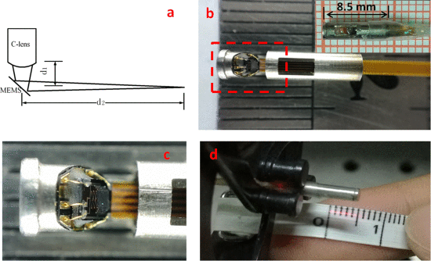
Design Components and Tradeoffs
Used a C-Lens rather than GRIN
Focal length was longer than using GRIN Lenses, but occupied much less space
Followed design from figure to the right
Mirror angled at 45˚ and tilts ±10° relative to X-plane
Mirror tilts ±10° relative to Y-plane
Tube diameter 7 mm
S. Luo et al., "A Miniature Endoscopic Optical Coherence Tomography Probe Based on C-Lens," in IEEE Photonics Journal, vol. 10, no. 5, pp. 1-10, Oct. 2018, Art no. 3901310, doi: 10.1109/JPHOT.2018.2870690.

Slide 9
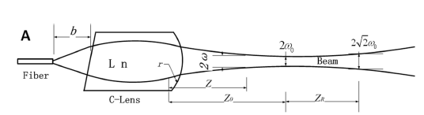
C-Lens Details
5 mm length
5 mm radius on curved side
1.78 refractive index (SF11 SCHOTT)
α angle 0 °
Collimates and focuses light source

Slide 10
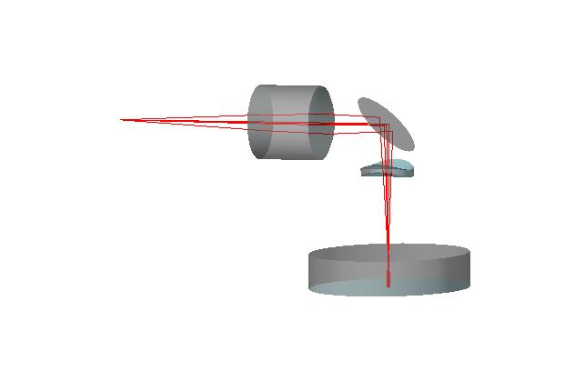
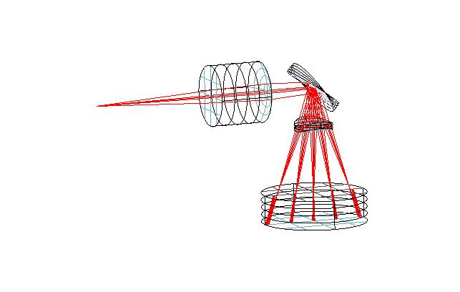
Design Overview
Beam (830 nm) is sent through a C-Lens
Mirror reflects beam through a window, onto the sample
C-Lens
Scanning Mirror
Window
Sample (ex: skin)

Slide 11
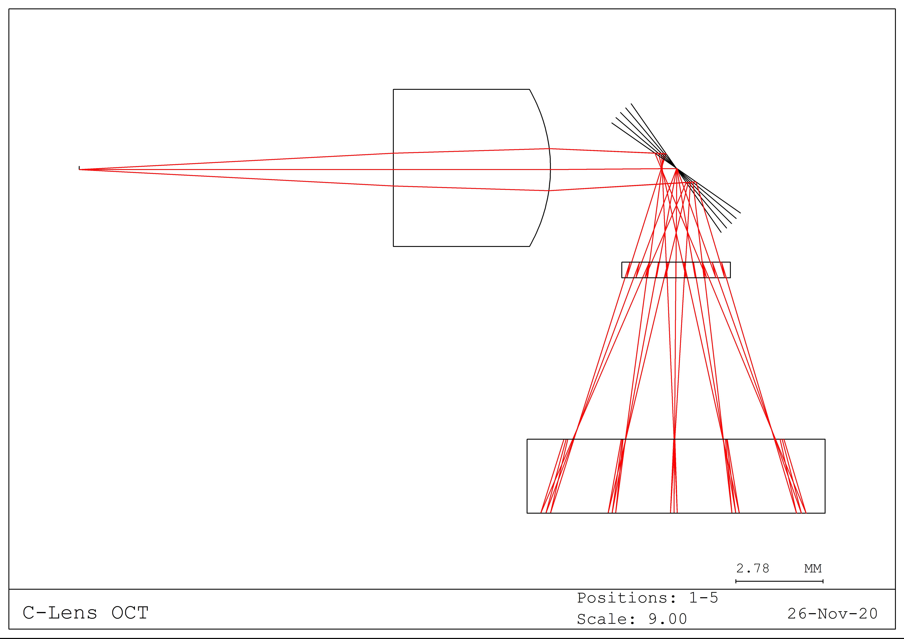
Performance
Side view of the system with 5 different mirror positions
Maximum scan Length in this direction is approximately 6.4 mm
Scan length in the opposite direction is ~ 4.15 mm
Working distance ~5.15 mm

Slide 12
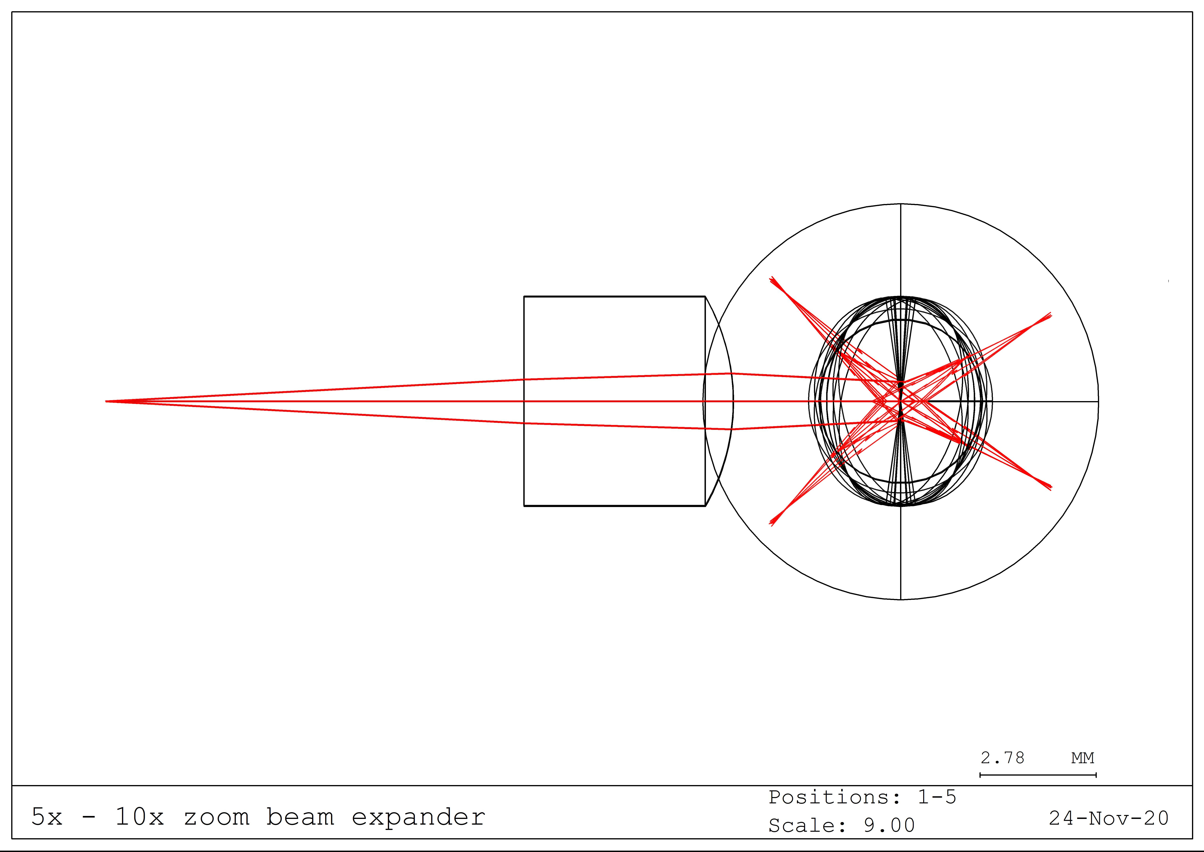
Performance (cont.)
Resulting field of view
~6.4 mm
~4.15 mm
Larger scan angle would be required for an increase

Slide 13
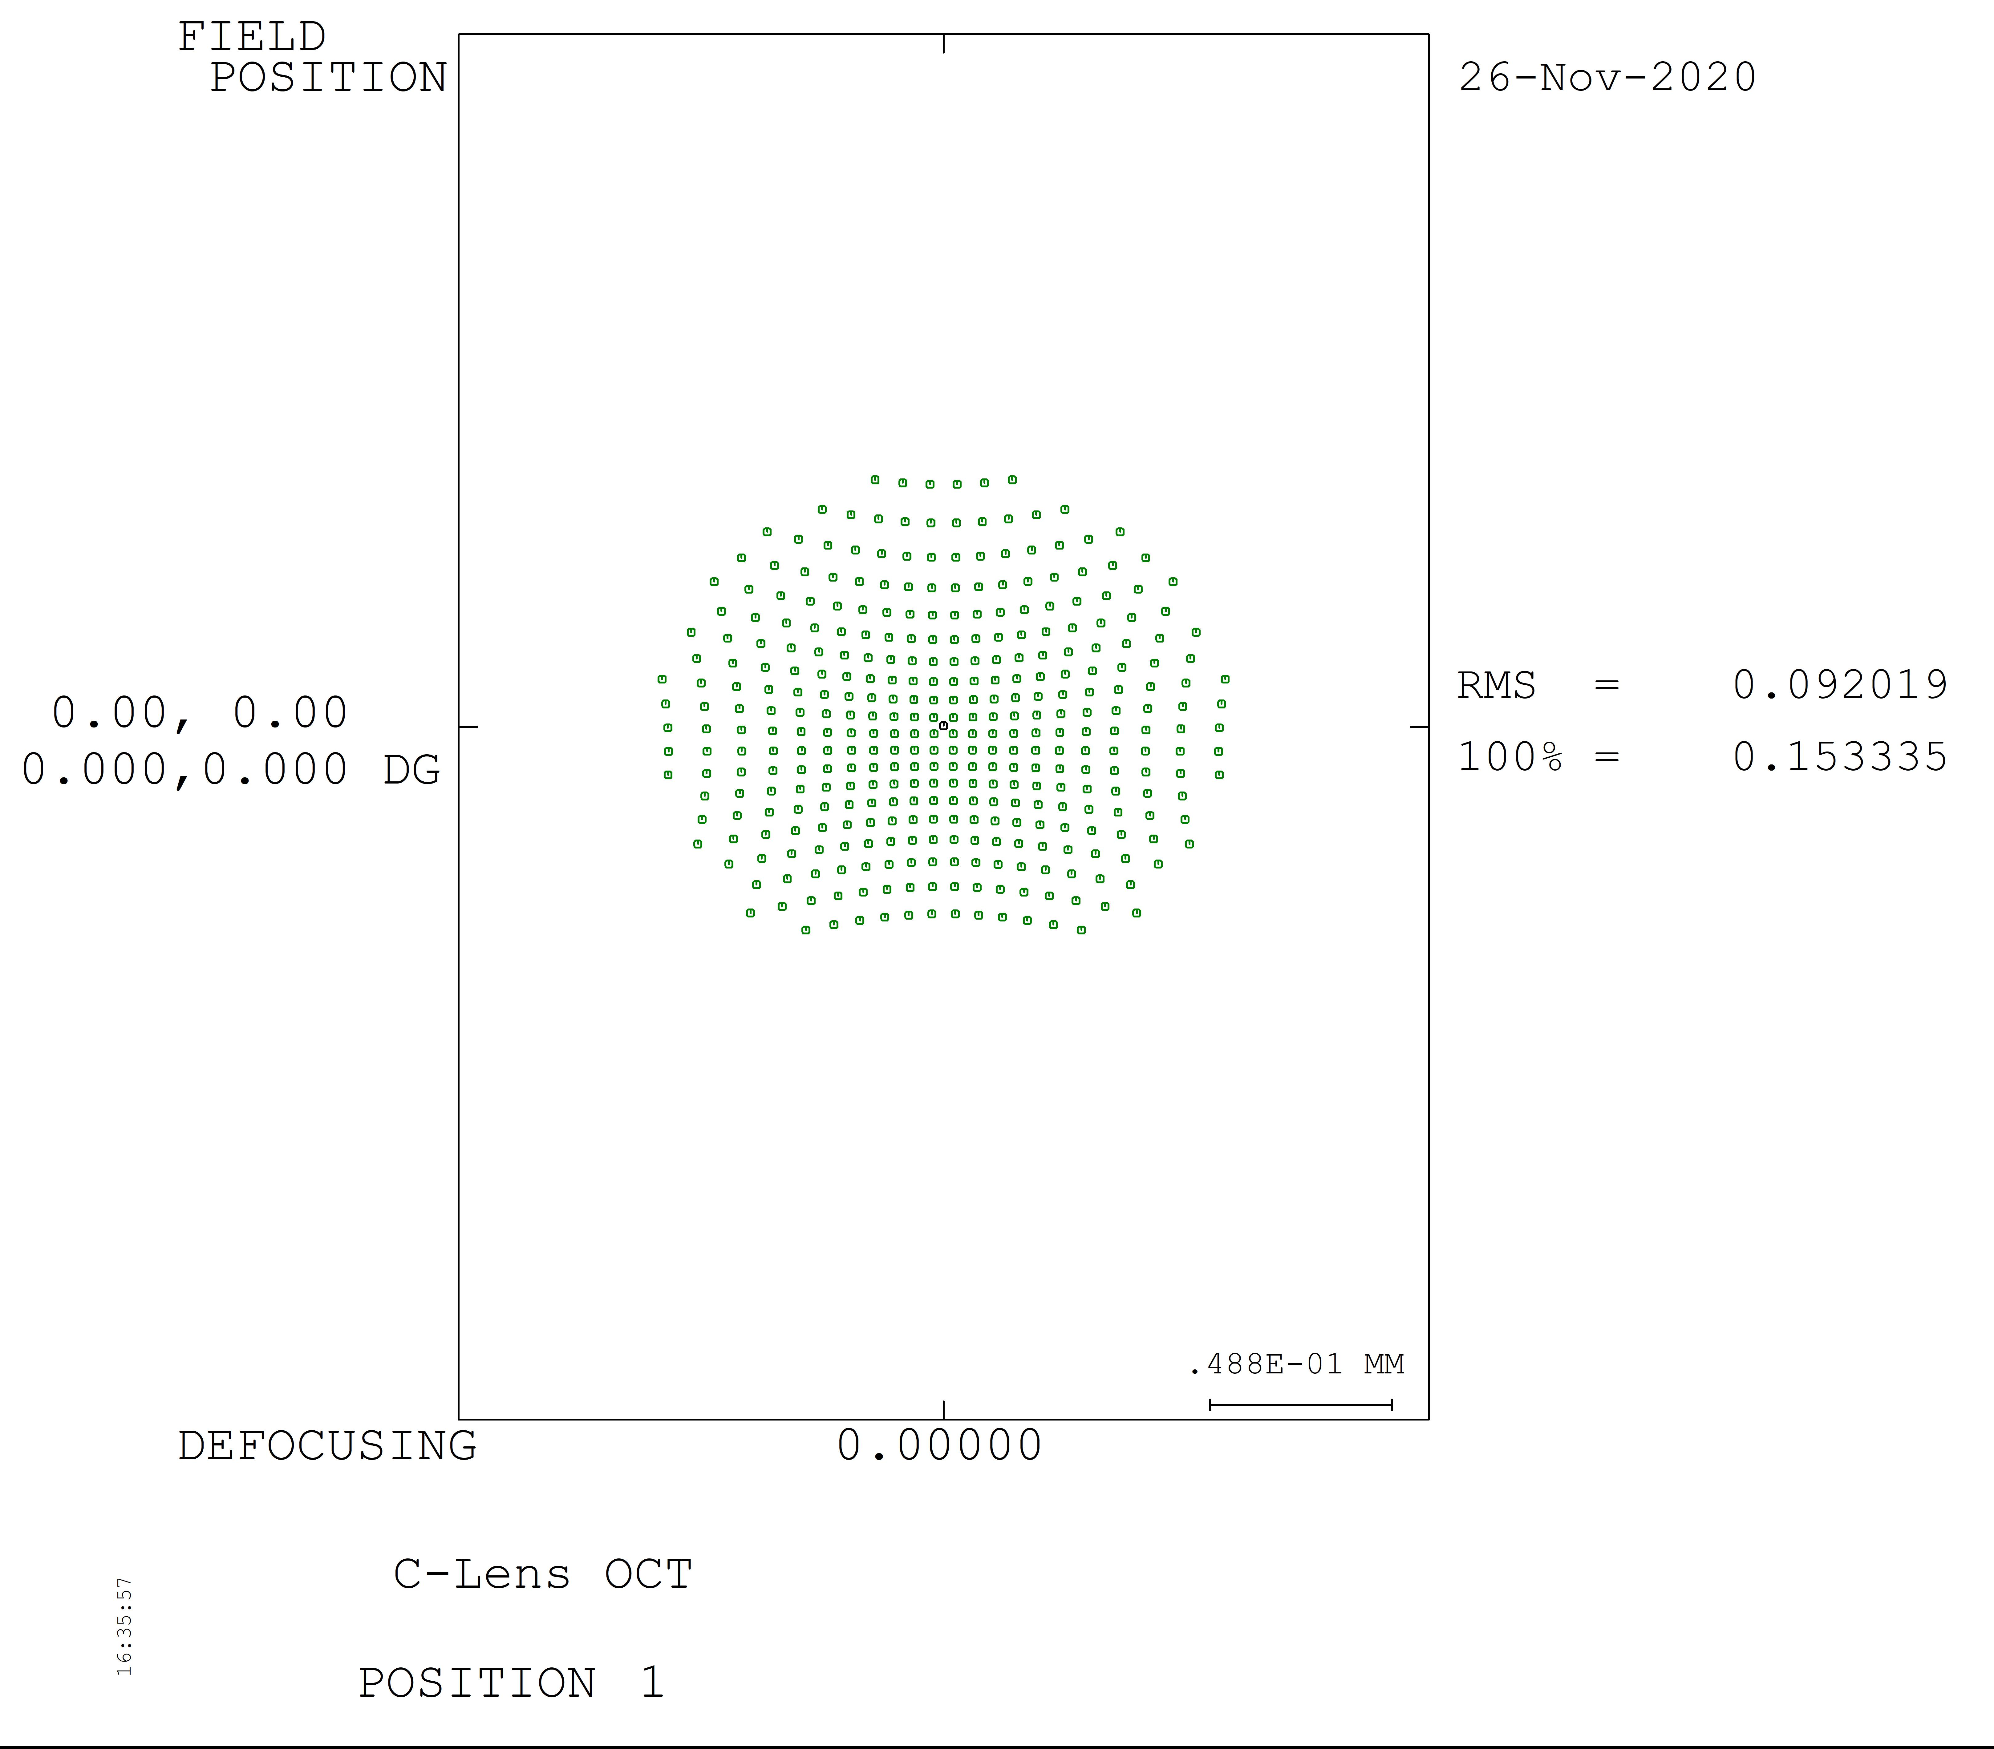
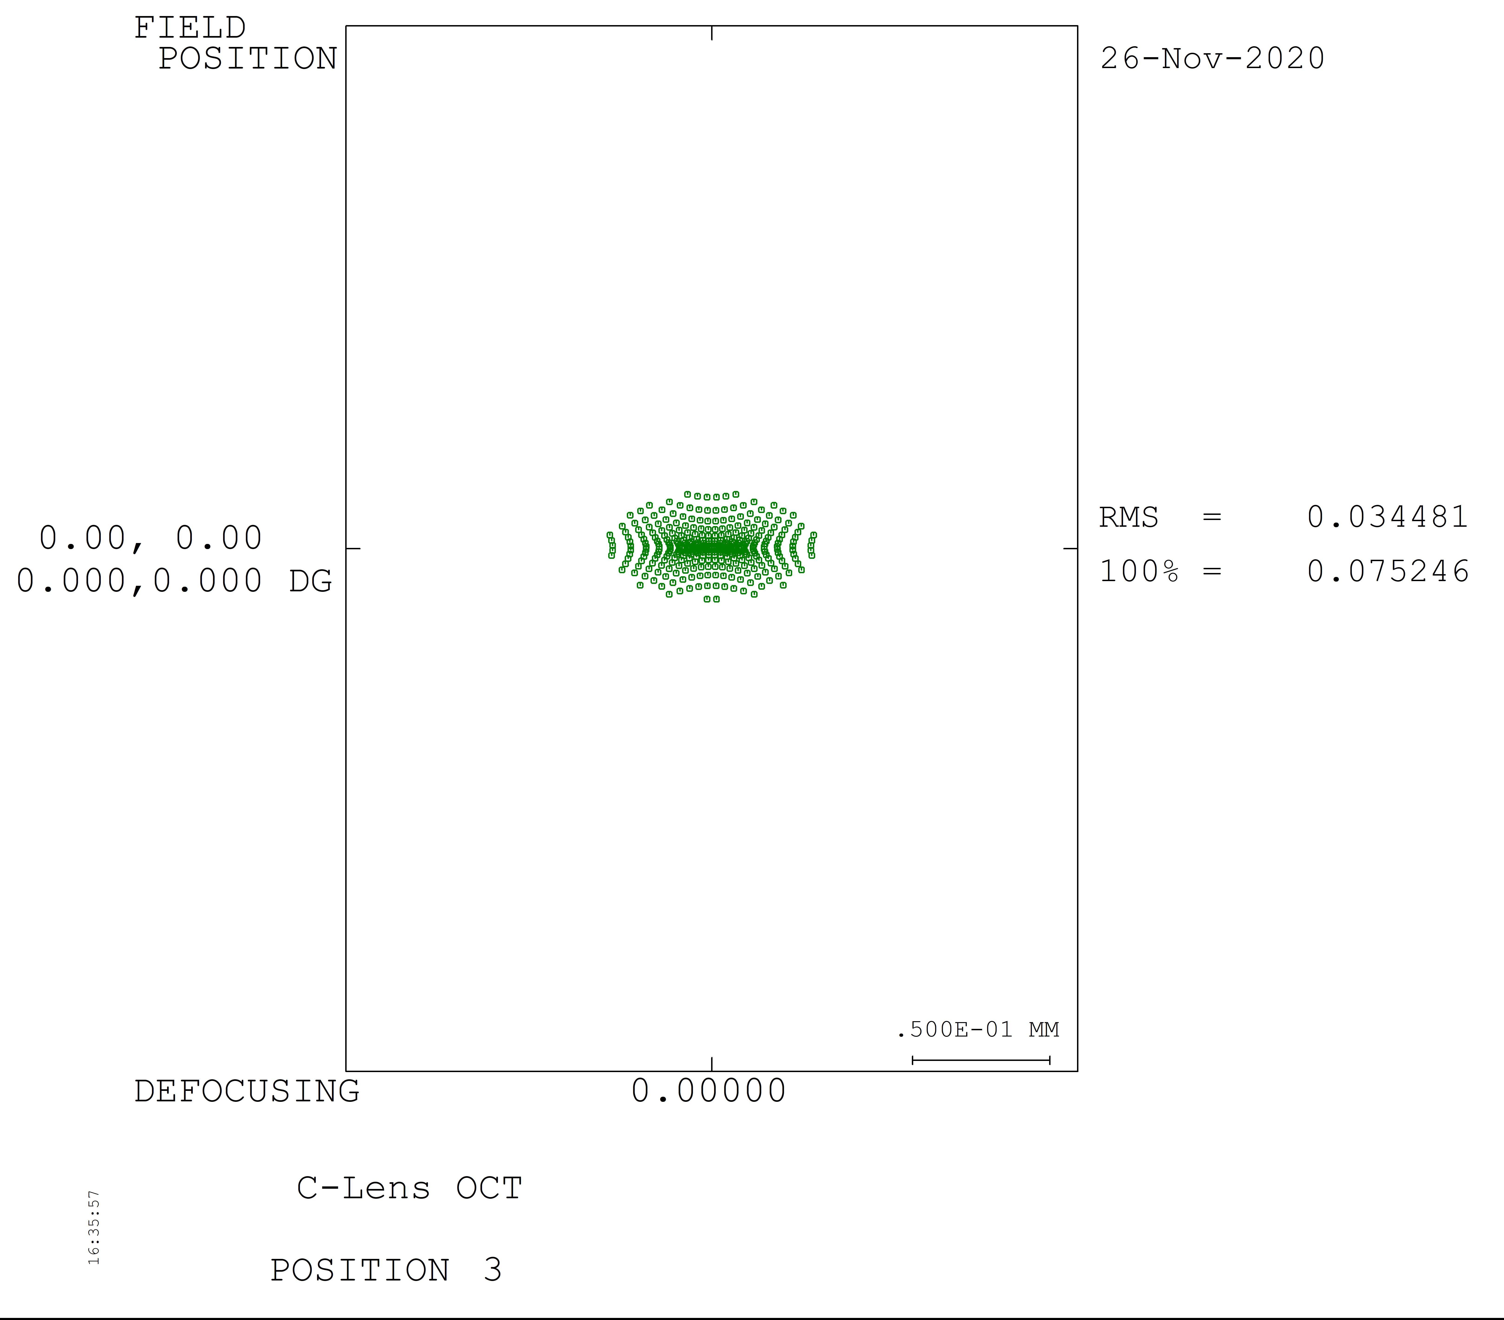
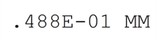
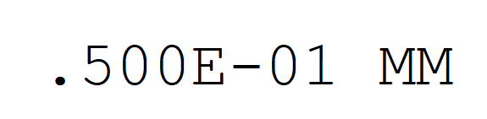
Spot Size Performance
Spot diagram to the right is the spot size with the best resolution (45° tilt)
Spot diagram to the left is at 35° tilt
Low RMS values and small spot size

Slide 14
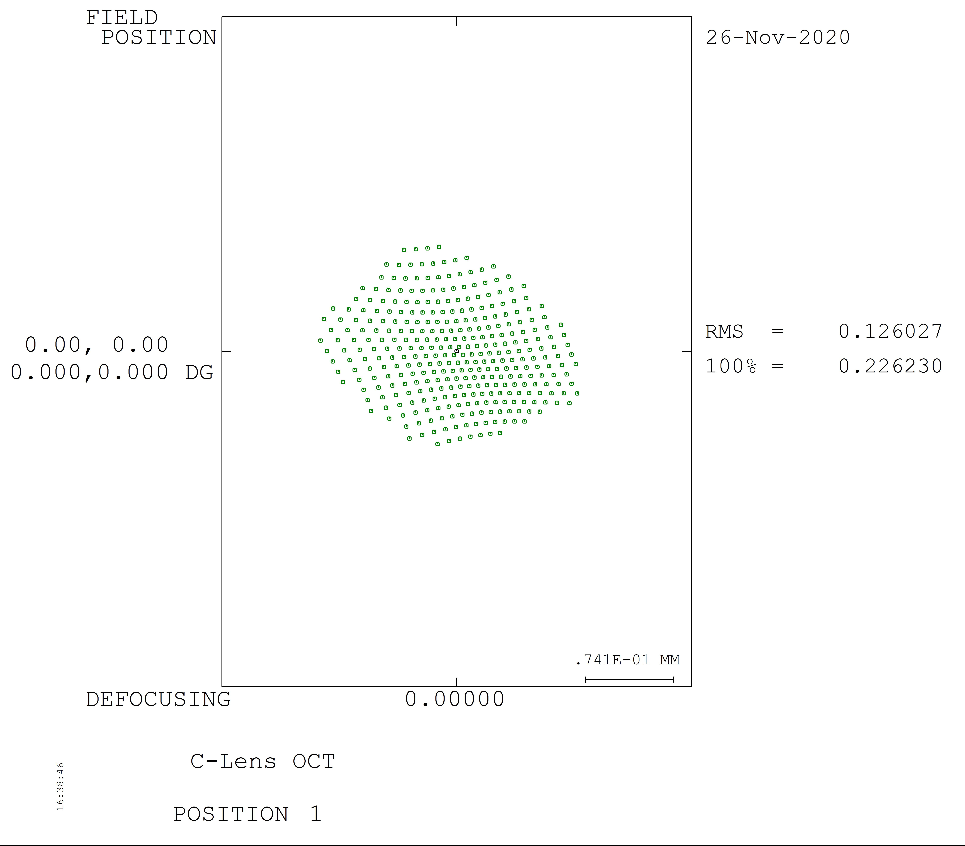
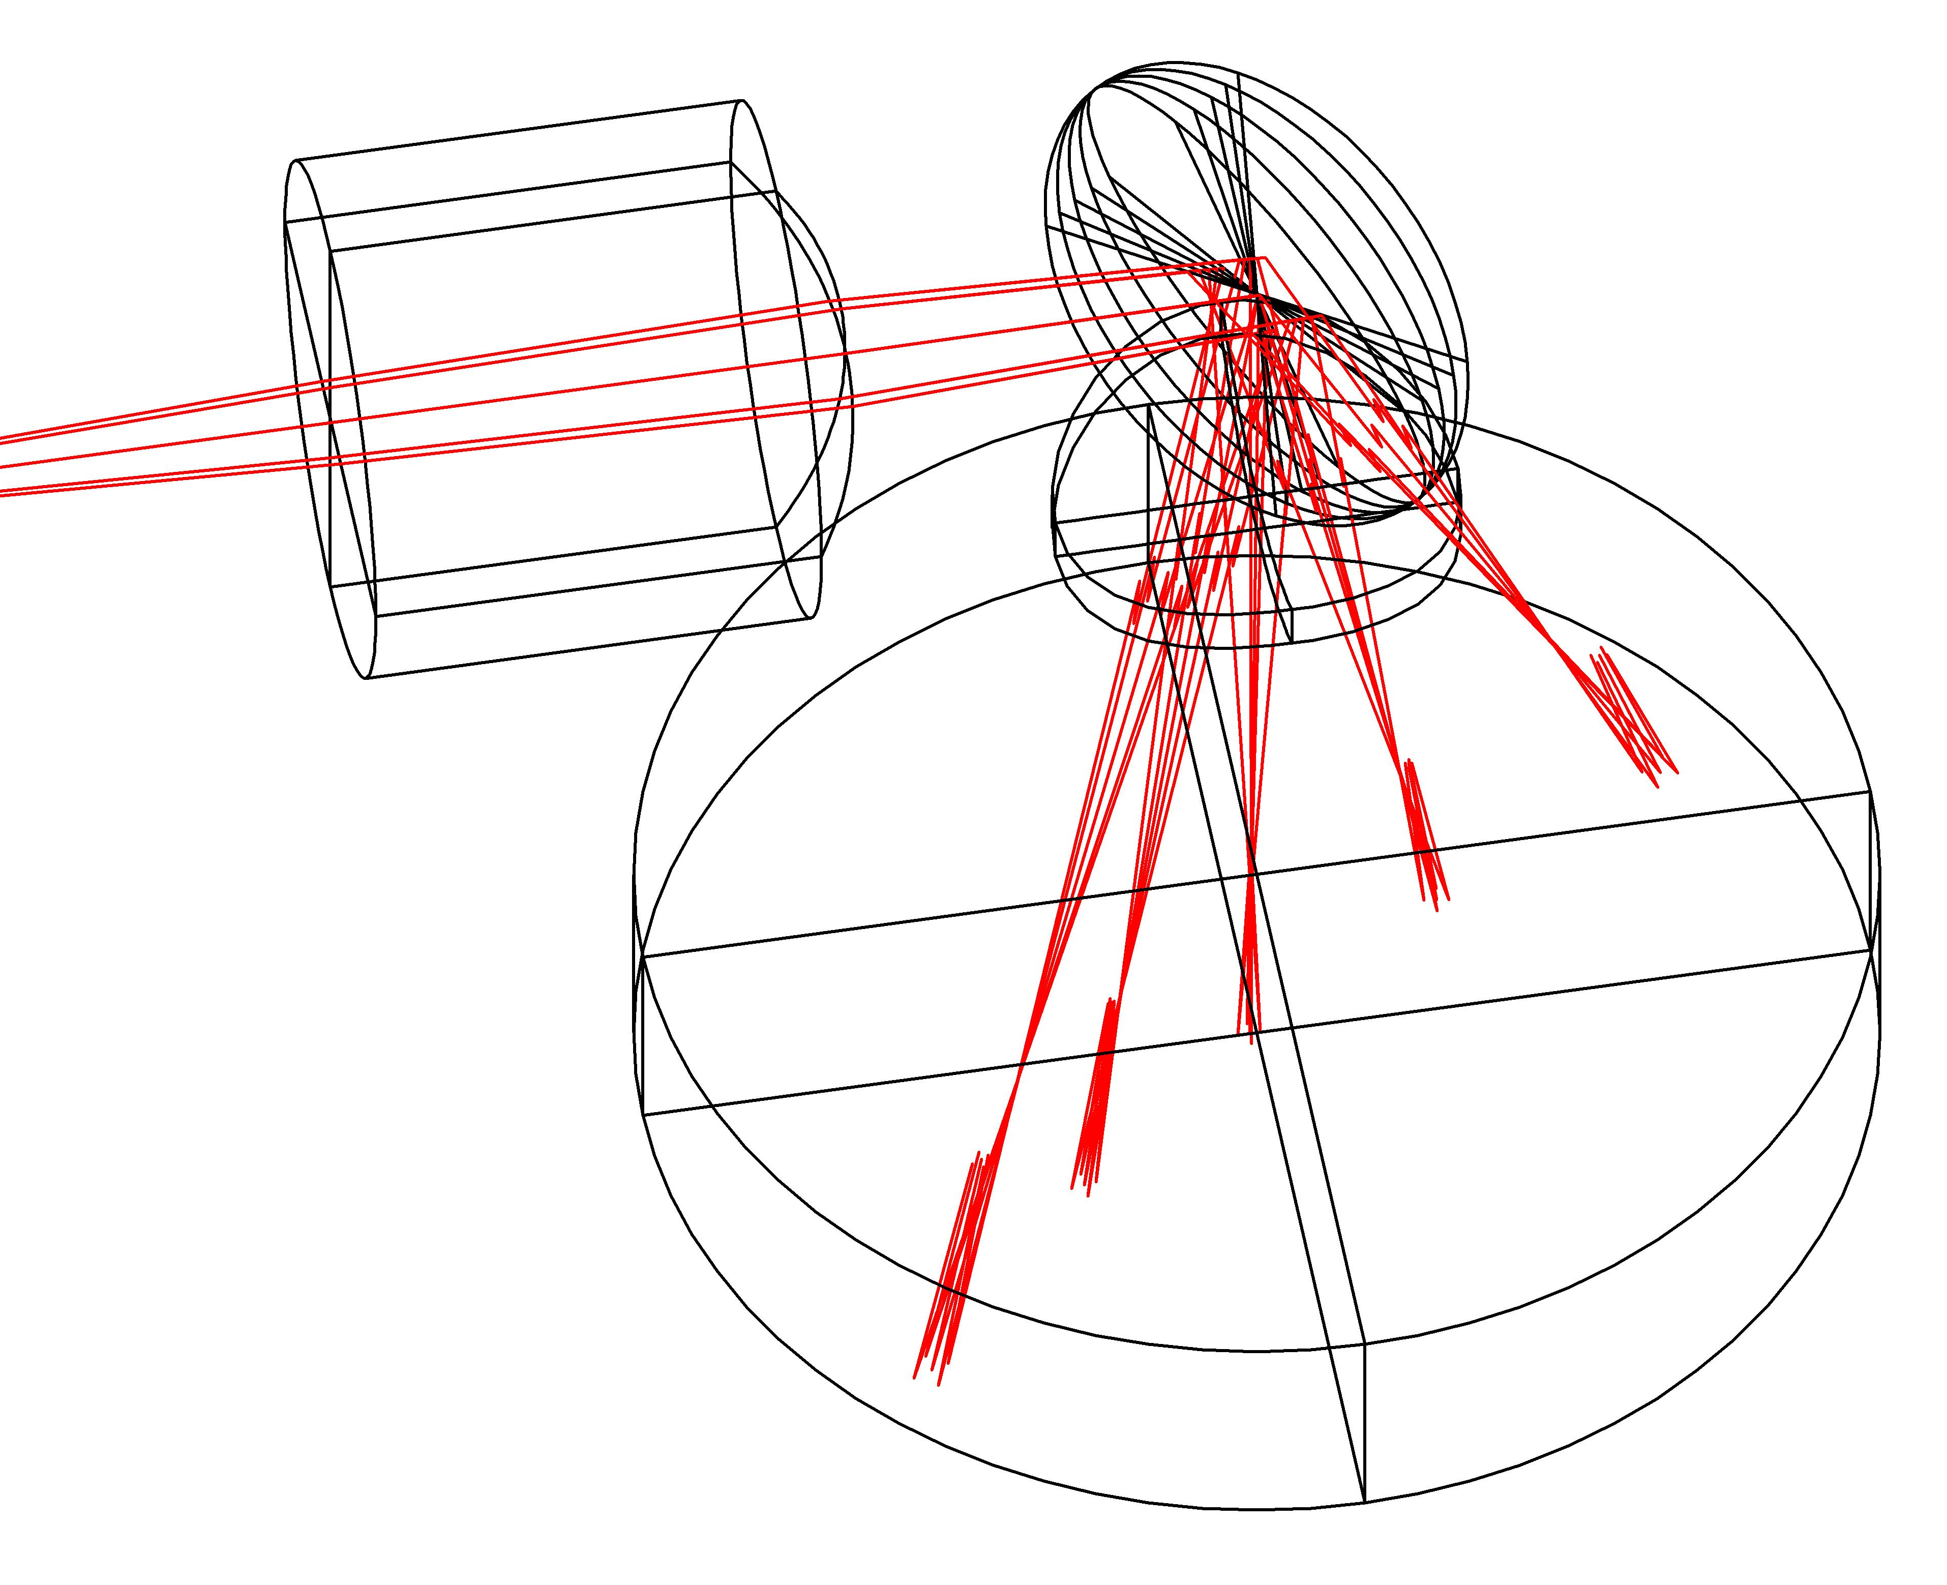
Spot Size Performance (cont.)
Spot size with Beta angle tilt included
Left: Alpha 35°, Beta -10°

Slide 15
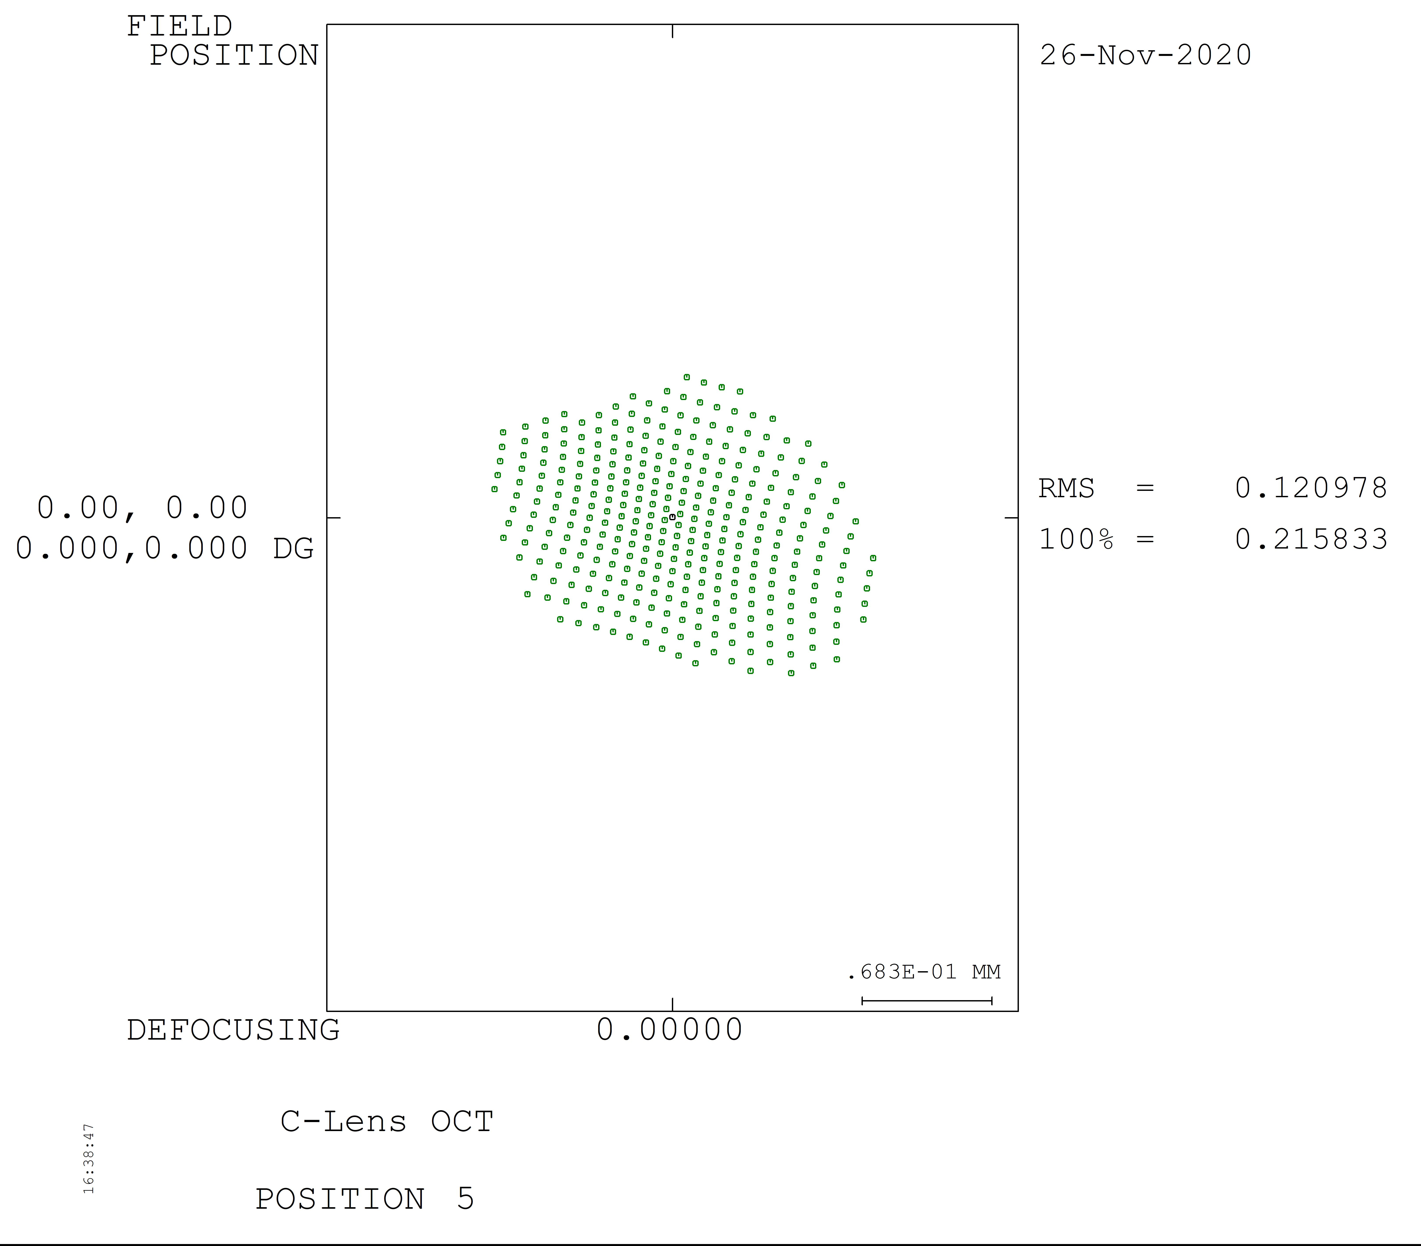
Spot Size Performance (cont.)
Spot size with Beta angle tilt included
Left: Alpha 55°, Beta 10°

Slide 16
Future Improvements
Increase of Beta scan angle to achieve 5 mm length
Improve transverse resolution
Fix decreasing resolution as scan moves away from the center angle

Slide 17
References
Aumann S., Donner S., Fischer J., Müller F. (2019) Optical Coherence Tomography (OCT): Principle and Technical Realization. In: Bille J. (eds) High Resolution Imaging in Microscopy and Ophthalmology. Springer, Cham. https://doi.org/10.1007/978-3-030-16638-0_3
“Introduction to OCT.” OBEL, University of Western Australia, obel.ee.uwa.edu.au/research/fundamentals/introduction-oct/.
Popescu, D. P., Choo-Smith, L. P., Flueraru, C., Mao, Y., Chang, S., Disano, J., Sherif, S., & Sowa, M. G. (2011). Optical coherence tomography: fundamental principles, instrumental designs and biomedical applications. Biophysical reviews, 3(3), 155. https://doi.org/10.1007/s12551-011-0054-7
S. Luo et al., "A Miniature Endoscopic Optical Coherence Tomography Probe Based on C-Lens," in IEEE Photonics Journal, vol. 10, no. 5, pp. 1-10, Oct. 2018, Art no. 3901310, doi: 10.1109/JPHOT.2018.2870690.

